Slide 1
Analyzing H1b data using Hadoop ecosystem
Presented by:
Name : Arti Hanmant Biradar
Student ID : S181107500054
Centre : NIIT Pune Deccan

Slide 2
big data
Big data is a term that describes the large volume of data – both structured and unstructured
Big data challenges include capturing data, data storage , data analysis, search, sharing, transfer, visualization, querying, updating and information privacy.

Slide 3

5 ‘V’ s of big data

Slide 4
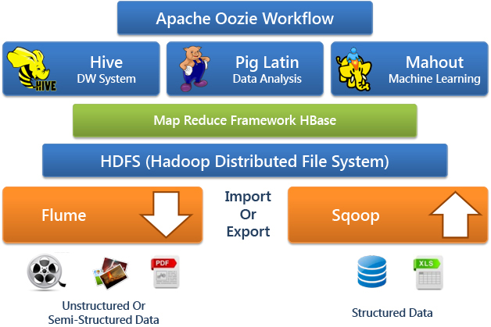
Hadoop ecosystem

Slide 5
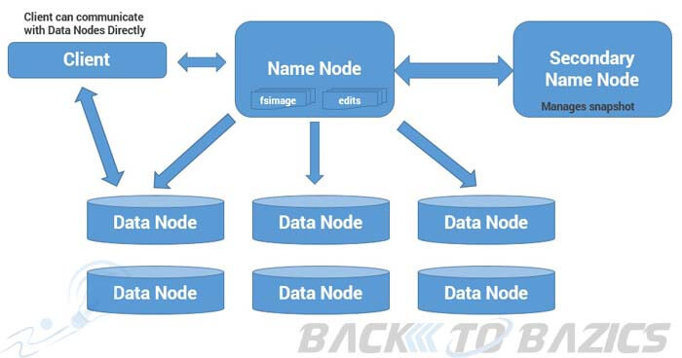
Hdfs architecture

Slide 6
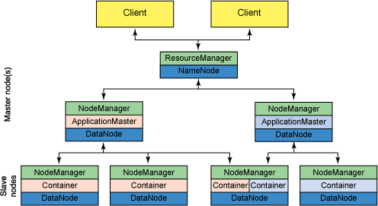
yarn

Slide 7
Advantages of hadoop
Scalable:
Hadoop is a highly scalable storage platform, because it can store and distribute very large data sets across hundreds of inexpensive servers that operate in parallel. Relational database systems (RDBMS) that can't scale to process large amounts of data.
Cost effective:
Hadoop also offers a cost effective storage solution for businesses. It offers computing and storage capabilities for hundreds of pounds per terabyte.
Fast:
The tools for data processing are often on the same servers where the data is located, resulting in much faster data processing.
Low Cost:
The open-source framework is free and uses commodity hardware to store large quantities of data.

Slide 8
Technology used
Mapreduce : a parallel processing software framework. It is comprised of two steps. Map step is a master node that takes input and partitions them into smaller sub-problems and then distributes them to worker nodes. After the map step has taken place, the master node takes the answer to all of the sub-problems and combines them to produce output.
Hive : a data warehousing and SQL like query language that presents the data in the form of tables. Hive programming is similar to data Warehousing.
Pig : a platform for manipulating data stored in HDFS and that includes a compiler for map reduce programs and high level language called Pig Latin. : It is a procedural language platform used to develop a script for MapReduce operations.
Sqoop :: It is used to import and export data to and from between HDFS and RDBMS

Slide 9
Analyzing factor
We will be performing analysis on the H1B visa applicants.
1 a) Is the number of petitions with Data Engineer job title increasing over
time?
b) Find top 5 job titles who are having highest growth in applications.
2 a) Which part of the US has the most Data Engineer jobs for each year?
b) find top 5 locations in the US who have got certified visa for each year.
3)Which industry has the most number of Data Scientist positions?
4)Which top 5 employers file the most petitions each year?
5) Find the most popular top 10 job positions for H1B visa applications for each year?

Slide 10
Analyzing factor
6) Find the percentage and the count of each case status on total applications for each year. Create a graph depicting the pattern of All the cases over the period of time.
7) Create a bar graph to depict the number of applications for each year
8) Find the average Prevailing Wage for each Job for each Year (take part time and full time separate)
9) Which are top ten employers who have the highest success rate in petitions?
10) Which are the top 10 job positions which have the highest success rate in petitions?
11) Export result for question no 10 to MySql database.

Slide 11
1 a) Is the number of petitions with Data Engineer job title increasing over TIME?
Technology used : Mapreduce
Solution :
Year No.Of Application
2011 18
2012 32
2013 41
2014 89
2015 160
2016 251

Slide 12
1b) Find top 5 job titles who are having highest growth in applicatios.
Technology used : Mapreduce
Solution :
job_title Average growth
(SENIOR SYSTEMS ANYLIST JC60, 4229.8)
(SOFTWARE DEVELOPER 2, 3382.8)
(MODULE LEAD, 3195.2)
(SYSTEM ANYLIST JC65, 2969.8)
(LEAD, 2507.0)

Slide 13
2 a) Which part of the US has the most Data Engineer jobs for each year?
Technology used : Pig
Data Engineer work-site No Of Application
(DATA ENGINEER,SAN FRANCISCO,CALIFORNIA,2011,3)
(DATA ENGINEER,SAN FRANCISCO,CALIFORNIA,2012,7)
(DATA ENGINEER,MENLO PARK,CALIFORNIA,2013,10)
(DATA ENGINEER,MENLO PARK,CALIFORNIA,2014,13)
(DATA ENGINEER,SAN FRANCISCO,CALIFORNIA,2015,33)
(DATA ENGINEER,MENLO PARK,CALIFORNIA,2016,35)

Slide 14
2 b) find top 5 locations in the US who have got certified visa for each year.
Technology used : Hive
Solution : year 2011
NEW YORK, NEW YORK 2011 23172
HOUSTON, TEXAS 2011 8184
CHICAGO, ILLINOIS 2011 5188
SAN JOSE, CALIFORNIA 2011 4713
SAN FRANCISCO, CALIFORNIA 2011 4711

Slide 15
3)Which industry has the most number of Data Scientist positions?
Technology used : Mapreduce
Solution : Industry No of Jobs
STATISTICIANS, 369
COMPUTER AND INFORMATION RESEARCH SCIENTISTS, 283
OPERATIONS RESEARCH ANALYSTS, 237
Computer and Information Research Scientists, 115
COMPUTER OCCUPATIONS, ALL OTHER, 113
MATHEMATICIANS, 107

Slide 16
4)Which top 5 employers file the most petitions each year?
Technology used : Mapreduce
Solution :
Year 2011
Employer Name Year Count
TATA CONSULTANCY SERVICES LIMITED 2011, 5416 MICROSOFT CORPORATION 2011, 4253 DELOITTE CONSULTING LLP 2011, 3621 WIPRO LIMITED 2011, 3028 COGNIZANT TECHNOLOGY SOLUTIONS U.S. CORPORATION 2011,2721

Slide 17
5) Find the most popular top 10 job positions for H1B visa applications for each year?
Technology used : Hive
Solution : year 2011
Year Job_Title Count Rank
2011 PROGRAMMER ANALYST 31799 1
2011 SOFTWARE ENGINEER 12763 2
2011 COMPUTER PROGRAMMER 8998 3
2011 SYSTEMS ANALYST 8644 4
2011 BUSINESS ANALYST 3891 5
2011 COMPUTER SYSTEMS ANALYST 3698 6
2011 ASSISTANT PROFESSOR 3467 7
2011 PHYSICAL THERAPIST 3377 8
2011 SENIOR SOFTWARE ENGINEER 2935 9
2011 SENIOR CONSULTANT 2798 10

Slide 18
6) Find the percentage and the count of each case status on total applications for each year. Create a graph depicting the pattern of All the cases over the period of time.
Technology used : Pig
Solution :
Year certified certified withdrawn denied
2011 84.83 3.23 8.11
2012 84.85 7.48 5.07
2013 86.61 8.01 2.74
2014 87.62 6.99 2.29
2015 88.45 6.63 1.76
2016 87.93 7.26 1.41

Slide 19
7) Create a bar graph to depict the number of applications for each year
Technology used : Hive
Solution :
Year Applicant
2011 358767
2012 415607
2013 442114
2014 519427
2015 618727
2016 647803

Slide 20
8) Find the average Prevailing Wage for each Job for each Year (take part time and full time separate)
Technology used : Hive
Solution : Year 2011
Job_title Full Time Position Year Average Prevailing Wage
ASSOCIATE SQA ENGINEER Y 2011 9853122.909
TEACHER (MATHEMATICS) Y 2011 9491354
SENIOR AUDIT ASSOCIATE Y 2011 9422870
ELEMENTARY SCHOOL SPANISH TEACHER Y 2011 9078950
DATA ADMINISTRATOR Y 2011 8976796.8
SENIOR FINANCE MANAGER Y 2011 8831672.062
PRINCIPAL ARCHITECT Y 2011 8453338.3

Slide 21
9) Which are top ten employers who have the highest success rate in petitions?
Technology used : Pig
Solution :
Employear Name Total Success Rate
HTC GLOBAL SERVICES, INC. 1164 100.0
INFOSYS LIMITED 130592 99.540
DIASPARK, INC. 1419.0 99.506
ACCENTURE LLP 33447.0 99.393
TECH MAHINDRA (AMERICAS),INC 10732.0 99.338
TATA CONSULTANCY SERVICES LIMITED 64726 99.337

Slide 22
10) Which are the top 10 job positions which have the highest success rate in petitions?
Technology used : Pig
Solution :
Job_Title Total Success Rate
PRODUCTION SUPPORT LEAD – US 1301.0 100.0
ASSOCIATE CONSULTANT - US 4393.0 99.93
SYSTEMS ENGINEER - US 10036.0 99.90
TEST ENGINEER - US 2198.0 99.86
PRODUCTION SUPPORT ANALYST – US 1451.0 99.86
TEST ANALYST - US 4958.0 99.81

Slide 23
11) Export result for question no 10 to MySql database
Technology used : Sqoop and Mysql
Solution :
1.mysql –u root –p
Password$:hduser
2.create database h1b;
3.use h1b;
4.create table question11 (job_title varchar(200) ,success_rate float, petitions int) ;
+--------------+--------------+------+-----+---------+-------+ | Field | Type | Null | Key | Default | Extra | +--------------+--------------+------+-----+---------+-------+ | job_title | varchar(200) | YES | | NULL | | | success_rate | float | YES | | NULL | | | petitions | int(11) | YES | | NULL | | +--------------+--------------+------+-----+---------+-------+
5. mysql> describe question11;
6.Sqoop export –connect jdbc:mysql://localhost/h1b –username root –password hduser –export-dir /project/question101 –input-fields-terminated-by ’\t’;

Slide 24
Conclusion
Petitions for data engineer job are increasing over time.
Jobs for Data Science are more In Statistician industries.
Success rate of INFOSYS LIMITED is more .
For System Engineer –US has more success rate.
Sqoop is Usefull when we have data on HDFS that need to be exported into the MySQL tables or vice-versa.

Slide 25
Thank you

